Slide 1
Research Data
The key to the transformation of the next generation of
academic libraries and librarians
Cynthia Love CSIRO
Karen Visser ANDS

Slide 2

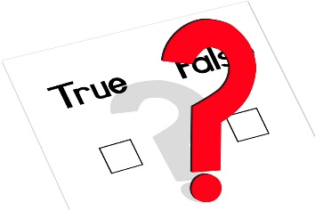
Why is Research Data such a hot topic for Librarians?
Citation Metrics & altmetrics
Reputation
Publishing & Collections building
Policy, Copyright, IP compliance
Client (et al) needs –
as publishers, resource seekers
Institutional Asset
Global network
Data is the Future...

Slide 3
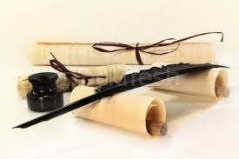
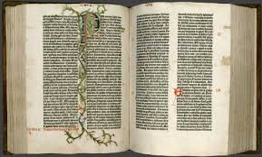
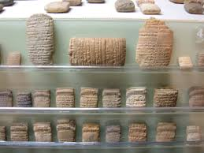


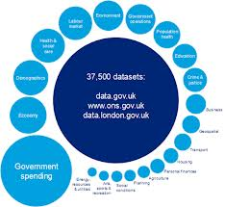


Slide 4
OECD principles and guidelines for access to research data from public funding 2007
Research Councils UK
Common Principles on Data Policy
National Institutes of Health USA Data Sharing policy
Australian Research Council
ARC Discovery Grant requirements, February 2014
Australian Code for the Responsible Conduct of Research (NHMRC, 2007)
Section 2: Management of Research Data & Primary Materials
Wellcome Trust
Position on data management and sharing
Bill & Melinda Gates Foundation’s Data Access Principles

Slide 5

Publishers
Publishers
Public Library of Science (PLOS)
New data policy, December 2013
“PLOS journals require authors to make all data underlying the findings described in their manuscript fully available without restriction, with rare exception”.
http://www.plosone.org/static/policies#sharing
Notes:
Journals increasingly require data that form the basis for
publications to be shared or deposited within an
accessible database or repository.

Slide 6
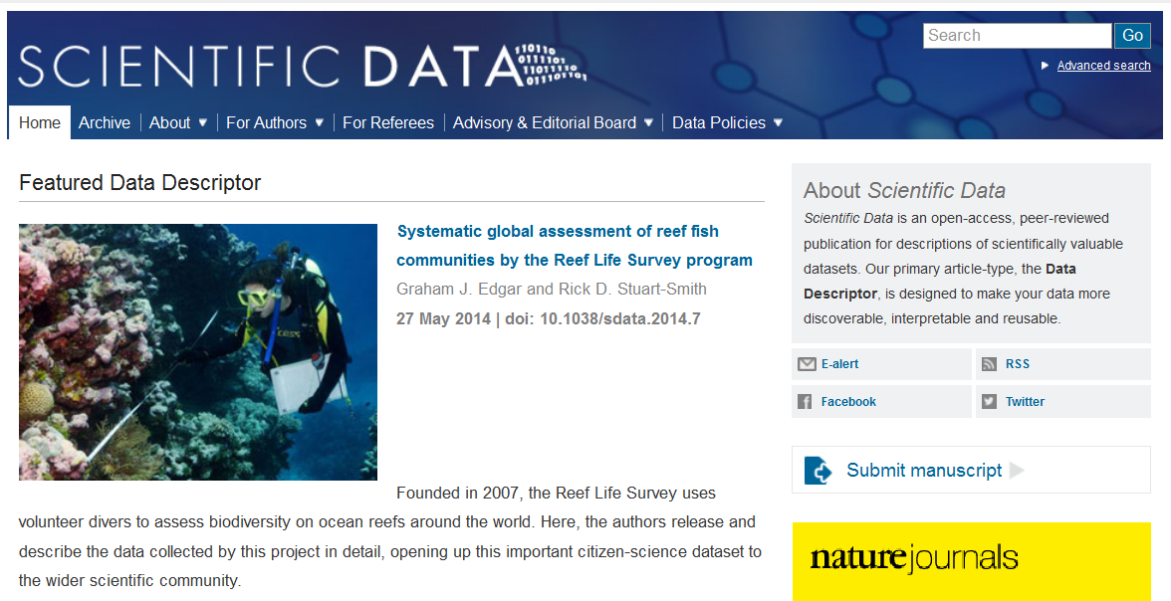
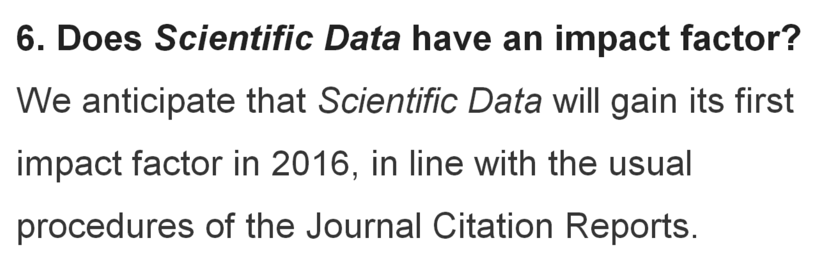
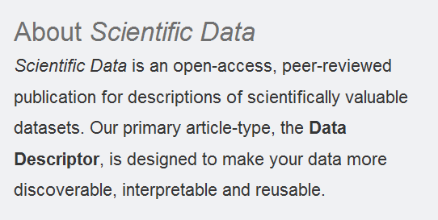
http://www.nature.com/sdata/
Launched May 2014

Slide 7
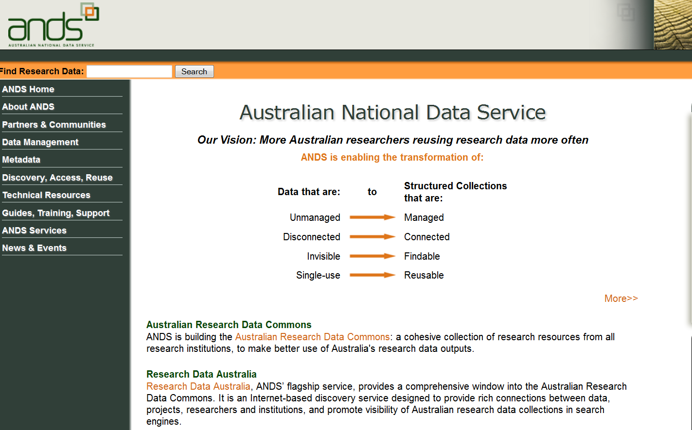
ands.org.au
Notes:
Not everyone in the audience may know about ANDS, so briefly, ANDS is a Commonwealth government funded initiative established to enable what we call, the four transformations across the Australian research sector.
HOLD UP ANDS PAMPHLET

Slide 8
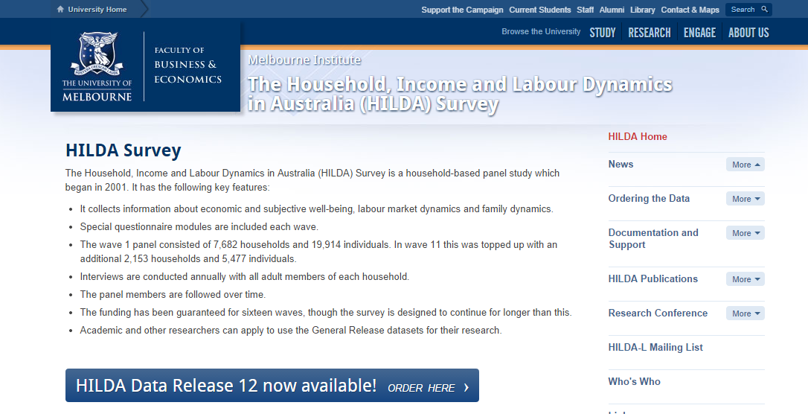

Slide 9
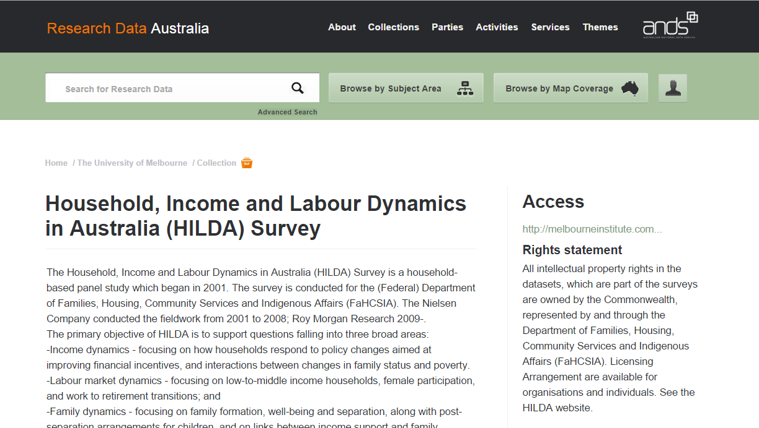

Slide 10
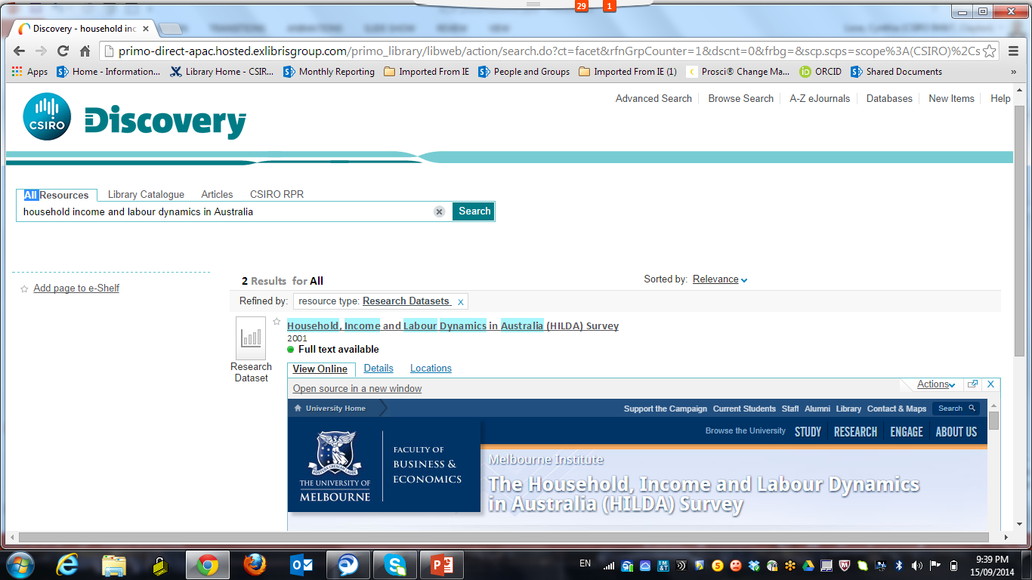

Slide 11
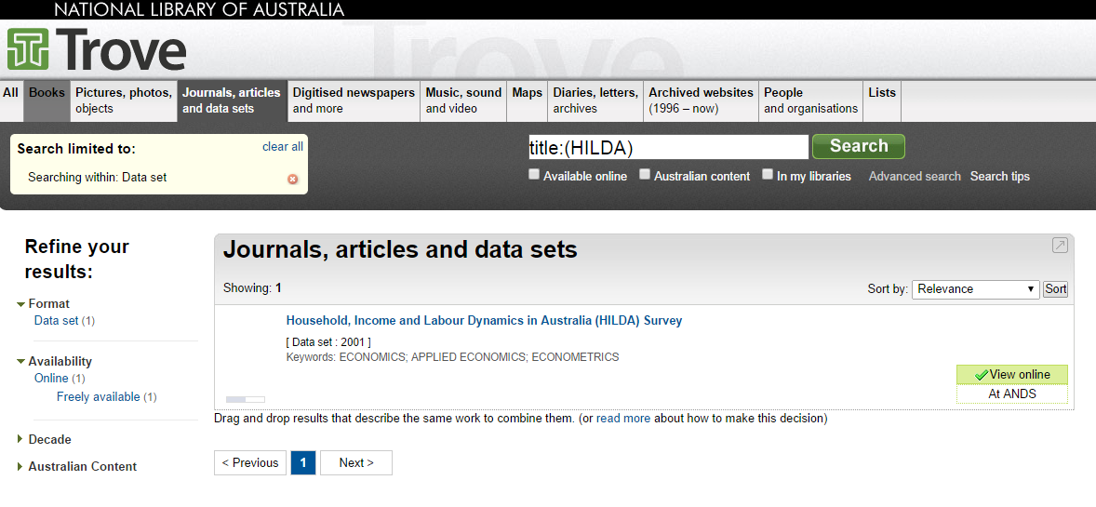

Slide 12
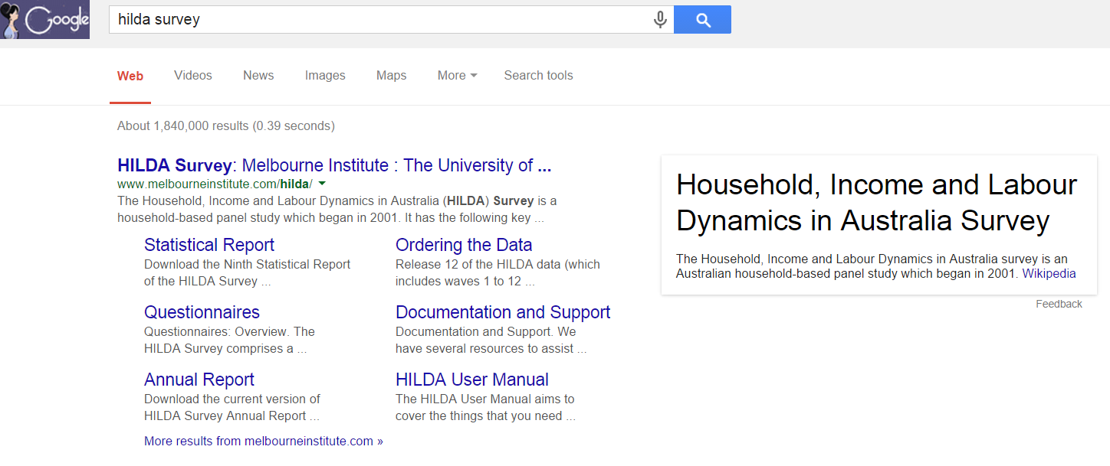

Slide 13
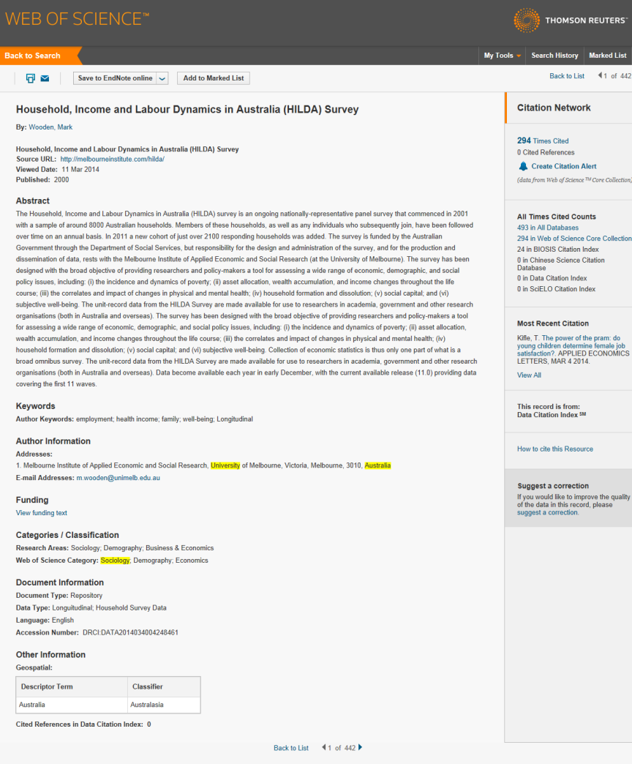
Metrics products

Slide 14
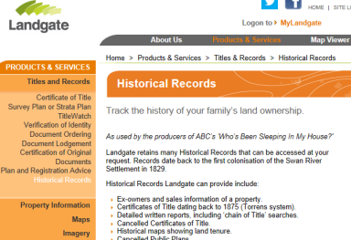
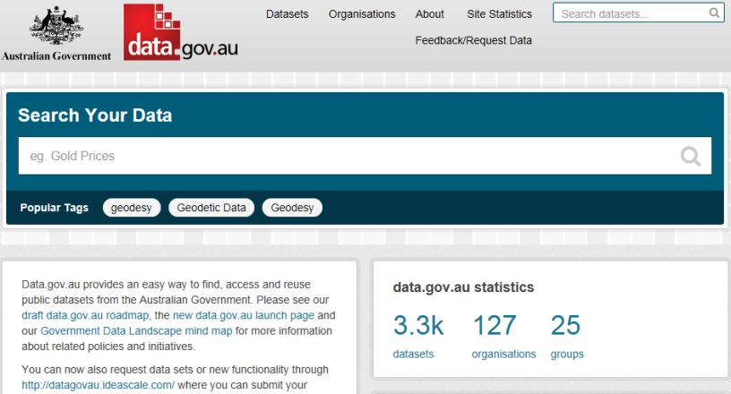
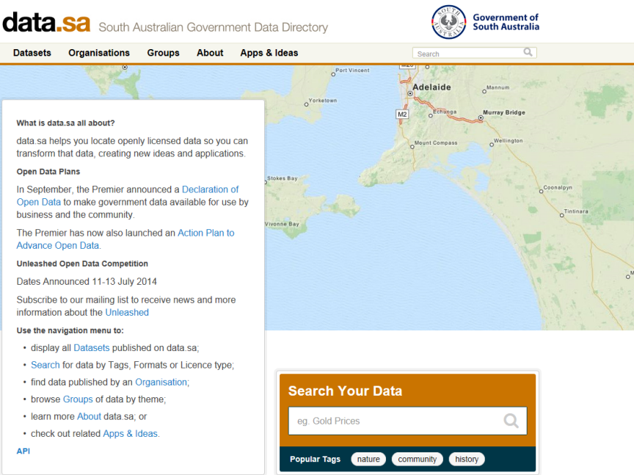
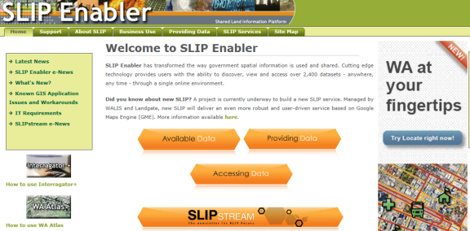
Government portals
Notes:
And of course, there are also numerous government portals that offer options for data publishing and discovery. Some are general in their coverage, while others have a particular domain flavour

Slide 15
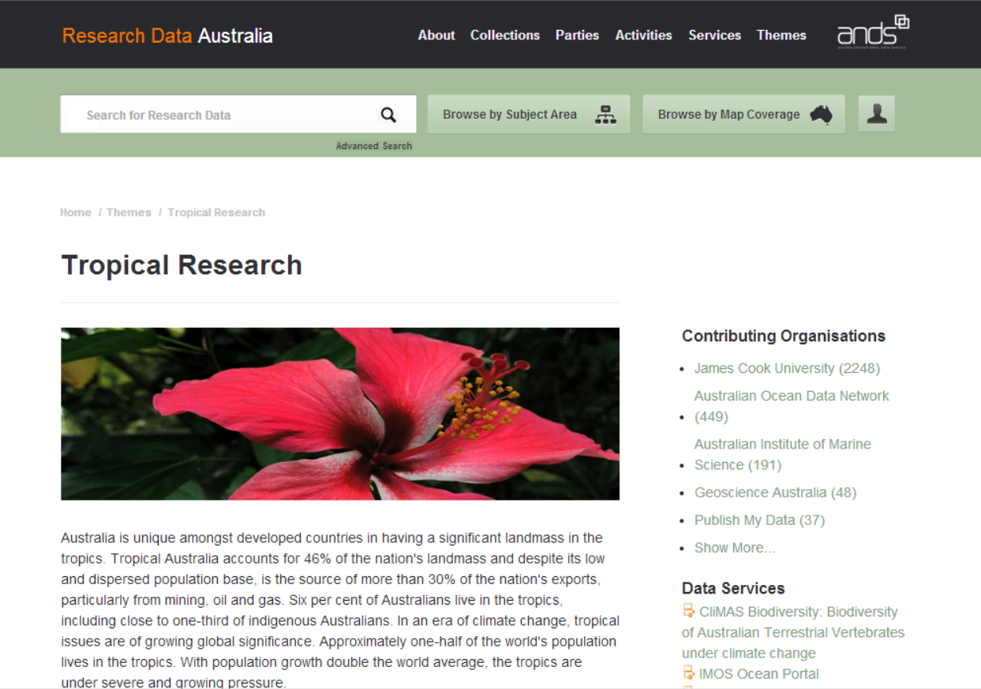
http://researchdata.ands.org.au/theme/tropical-research

Slide 16
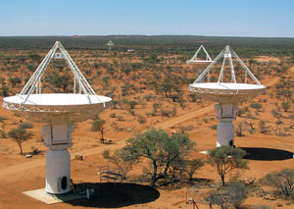
Describing and showcasing major collections
How to define and describe collections from major data streaming from a telescope?
Ask a librarian!
Notes:
Pic of SKA and open collection case study

Slide 17
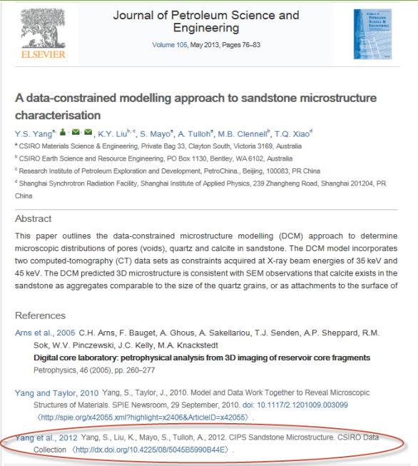
Publication in context: linking research outputs
Notes:
So, now you’ve published your data and made it discoverable. What next? One important thing you can do is cite your data in your publications. You might be able to see the example here where Sam Yang has cited his dataset in the reference list in his journal paper. Importantly, what this enables among other things, is the ability to track reuse of the data in the same way that we currently track reuse of journal articles – through citation. So it becomes possible to track the reach, impact and reuse of your data. This can be done through ‘formal metrics’ products such as the Data Citation Index

Slide 18
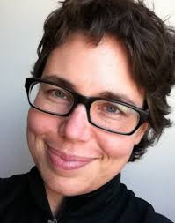
Researchers
Data reuse and the Open Data Citation Advantage
Heather Piwowar and Todd Vision
The citation benefit intensified over time...
...with publications from 2004 and 2005 cited 30 per cent more often if their data was freely available.
Every 100 papers with open data prompted 150 "data reuse papers" within five years
Original authors tended to use their data for only two years, but others re-used it for up to six years.
Piwowar HA, Vision TJ. (2013) Data reuse and the open data citation advantage. PeerJ 1:e175 http://dx.doi.org/10.7717/peerj.175
Notes:
Journals increasingly require data that form the basis for
publications to be shared or deposited within an
accessible database or repository.

Slide 19


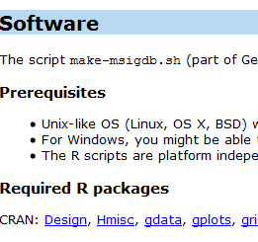
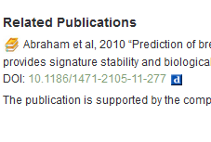
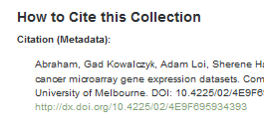
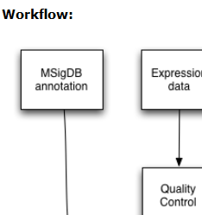
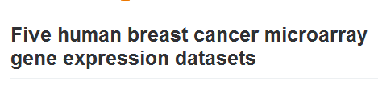
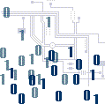
And what about...
  Visualisations
  Conference recordings
  Collaborations
  Funding

Slide 20
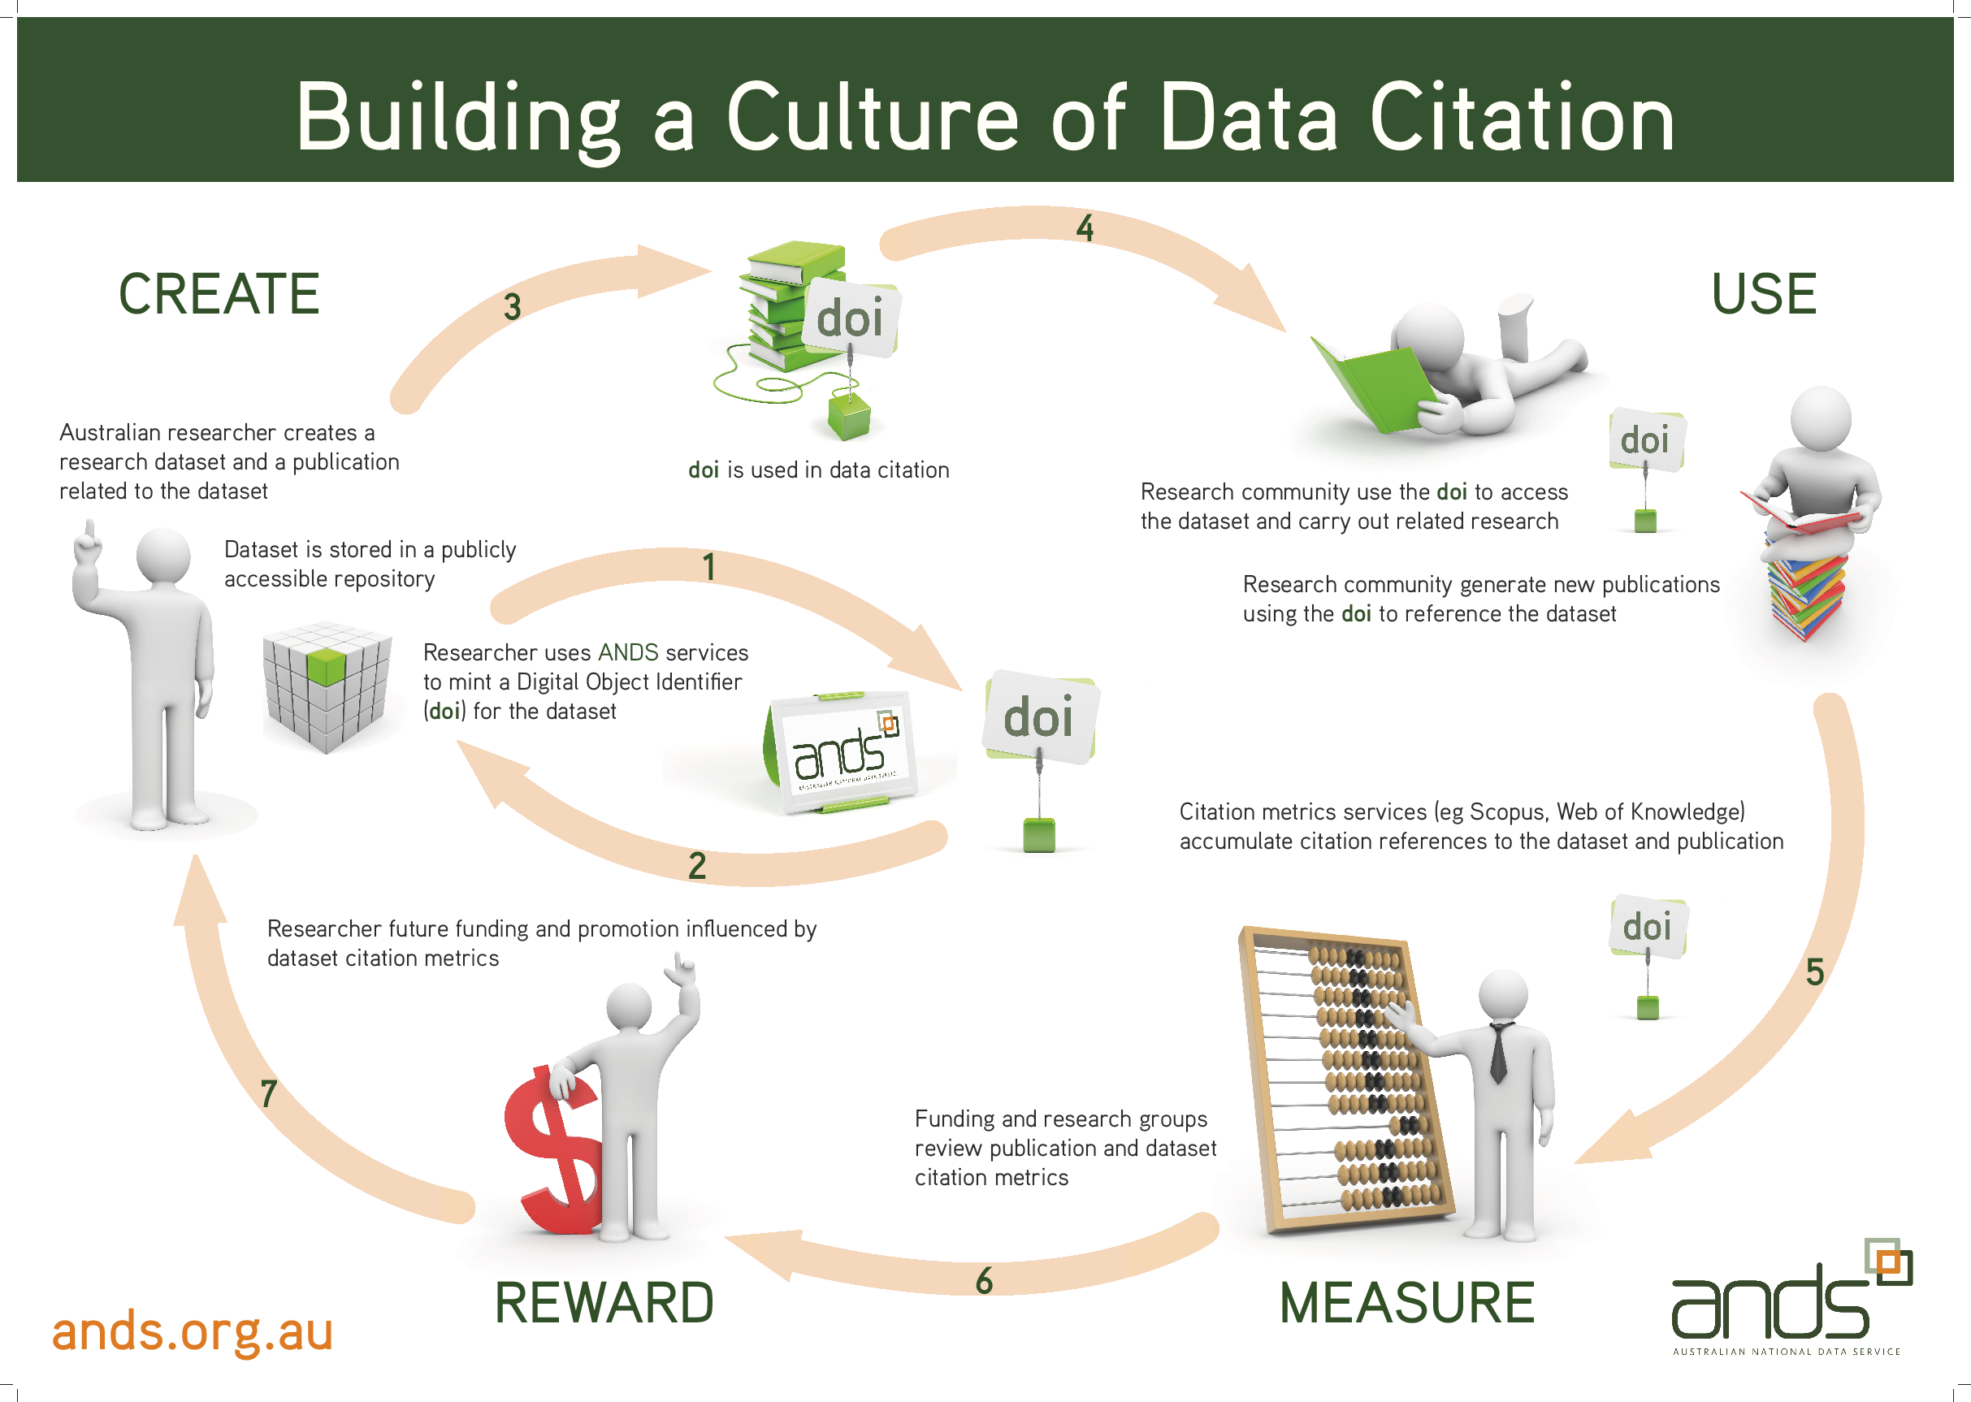
Notes:
The workshop today is all about data citation. Today we’ll be talking about various aspects of data citation, and you might find it useful to refer to your copy of this “virtuous loop of data citation”
So, let’s start by looking at what data citation is.

Slide 21
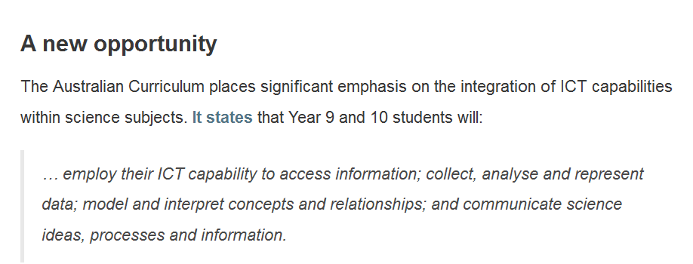
Data infused clients
http://www.australiancurriculum.edu.au/Science/General-capabilities

Slide 22
Turning Library services for teaching, learning & research
Orientation & Skills Training
Roadshows, displays, liaison
Reference interviews
Guides & online help
Collection building
Access, licensing, copyright
Resource management
Teaching resources
Publishing advice
Metrics
into Data infused Library services

Slide 23
Functional objectives: Information Outreach @ CSIRO
eResource Outreach
  Working with research groups to identify appropriate tools, establish alerts, provide high level assistance with the use of tools, Induction for new staff, current awareness at research group level
  Assistance with mobile use of eResources
Publication support
  Citation analyses & science review support
  Reference management advice & training, Journal impact advice
Research Data Management
  Data management planning, metadata management, data description, publication and citation

Slide 24
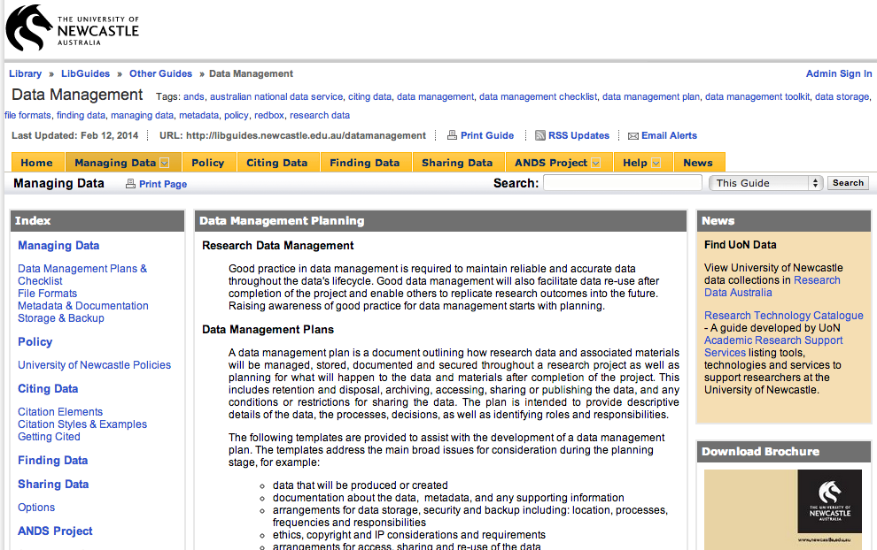
Training and Guides: users
University of Newcastle
http://libguides.newcastle.edu.au/content.php?pid=220059&sid=1827507
Notes:
Here’s a similar page from University of Newcastle

Slide 25
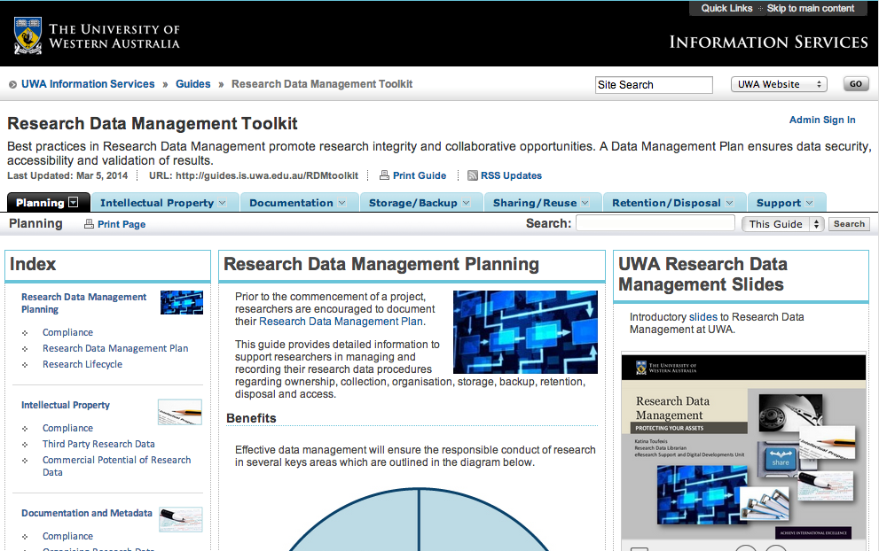
Training and Guides: producers
University of Western Australia
http://guides.is.uwa.edu.au/content.php?pid=319161&sid=2612215
Notes:
University of Western Australia

Slide 26
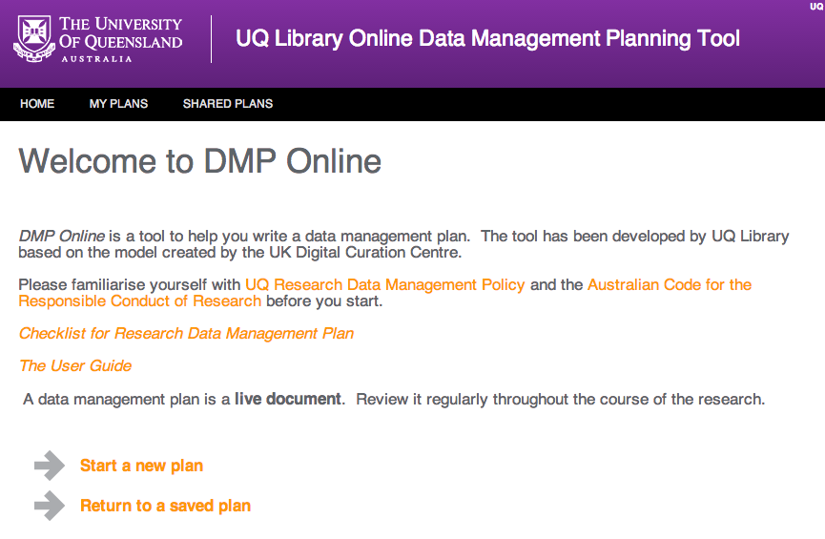
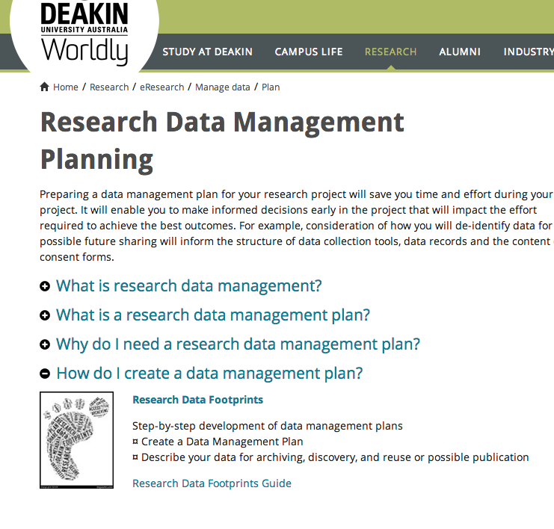
RDM at Aust. Uni. Libraries
Resource management
University of Queensland
https://dmponline.app.uq.edu.au/
Deakin University
http://www.deakin.edu.au/research/eresearch/manage-data/footprints-guide
Notes:
Most of the templates and checklists are static documents. University of Queensland has dmponline as well as a static document. It looks like Deakin University also has an online tool.
At University of Sydney there was a focus on seeking to bring together administrative systems to provide as much information as possible to prepopulate a DMP. I imagine that is is happening elsewhere.
I wonder what sort of response the institutions are having.

Slide 27
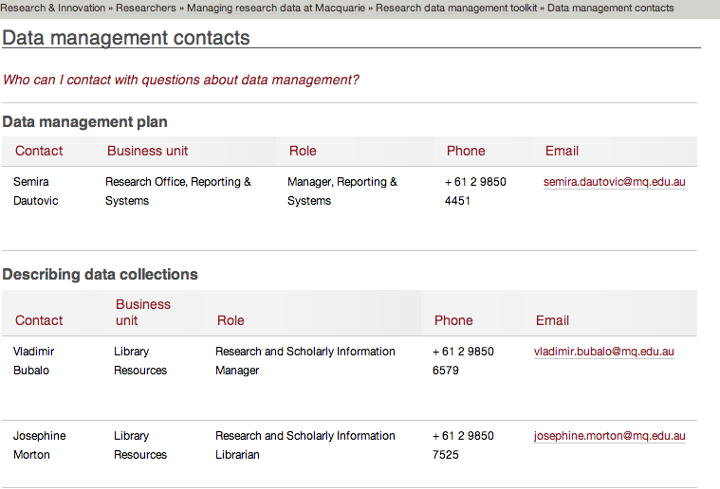
Individual advice
Macquarie University
http://www.research.mq.edu.au/for/researchers/managing_research_data_at_macquarie/macquarie_researcher_toolkit/data_management_contacts

Slide 28
Reference interviews*
Student approaches library staff to access
Child and Adolescent Component (1998) of the National Survey of Mental Health and Wellbeing
after reading a study that uses the data
* Based on a true story
Notes:
Student approached library staff member at UWA (Carole Kerr)
Found in ADA – but have to know to look there. E.g., if simply google the title of the survey get page of pubs. One library link on second page but it’s a dead end. Theres a link to a metadata record at ABS, but no details of data access (email address of researcher)

Slide 29
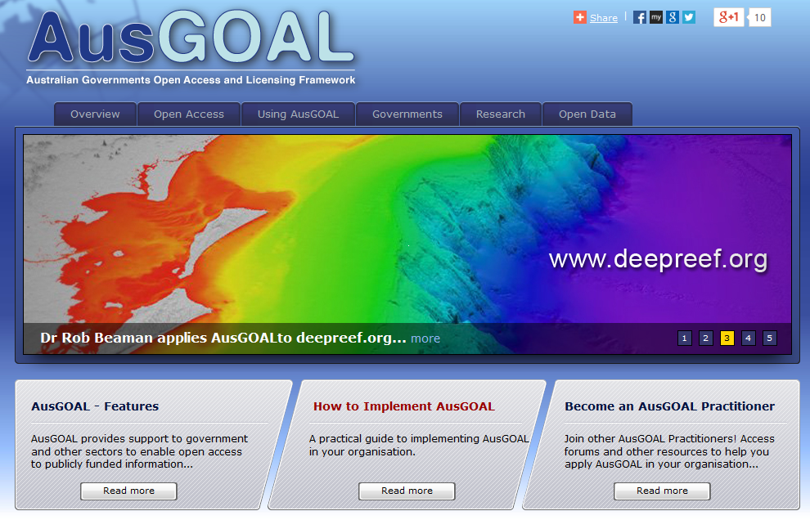
Access, IP, Licensing, Copyright

Slide 30
Find, Identify, Select, Obtain (Data!)
Building collections
  Government data portals - data.gov, data.gov.uk,
  data.govt.nz …
  Discipline specific –
  Pangaea, Polar Data Catalogue, ICPSR, Gene Expression Omnibus, Dryad …
  Organisational –
  NASA, World Health Organisation, United Nations, Gapminder....
  Lists of data repositories – DataCite, Databib, re3data.org …
  Research Data Australia
Atlas of Living Australia
Australian Data Archive
Tropical Data Hub
Australian Ocean Data Network
CSIRO Data Access Portal
data.gov.au
Institutional data repository
.... more
Notes:
Licenses: attaching a license agreement to the reuse of data, i.e., it can be reused for certain purposes and/or if the user (individual or organization agrees to conditions of use/security/storage)
There are levels of license from least to most restrictive: least (Attribution (BY) = you can rejig/build upon, even commercially, as long as credit it given to original creator) to no changes/non-commercial.
Restrictive license – circumstances where data is sensitive/personal (e.g., medical records), more conditions, often confidentiality issues.

Slide 31
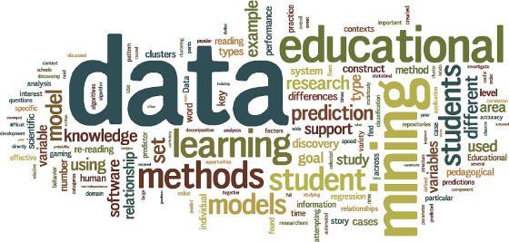
Library services ….
which support
teaching, learning & research…. in a
world
http://theteachingnut.blogspot.com.au/

Slide 32
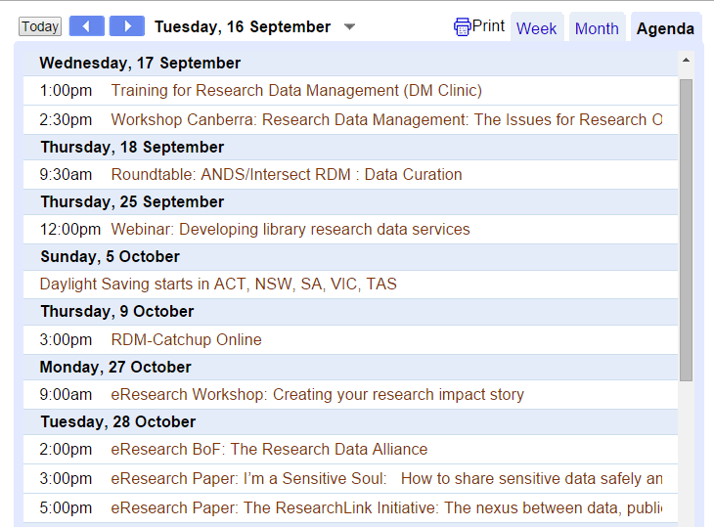
Skills Training: for Librarians
ands.org.au/events/index.html
Notes:
Seven of the pages included links to information about available RDM training. Several of these were links to MANTRA, the online RDM training site.

Slide 33

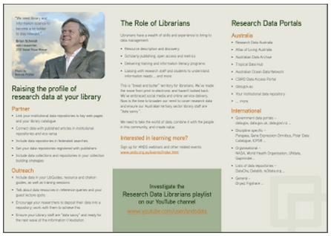
Embedding data in Librarianship

Slide 34
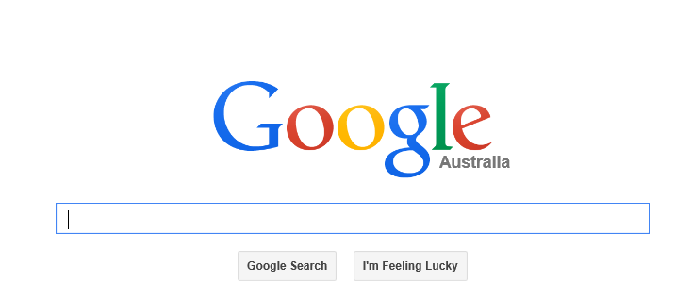
Hear from Australian Data Librarians
andsdata data librarians playlist

Slide 35
ANDS-CAUL Webinar
Thurs 25 Sept, 12-1pm AEST
ands.org.au >> events
  Katina Toufexis
  Research Data Coordinator, University of Western Australia
  Amanda Nixon
  Manager of eResearch@Flinders, Flinders University
  Beth Crawter
  Information and Research Services Coordinator, University of the Sunshine Coast

Slide 36
Policy, Copyright, IP compliance
Reputation
Citation Metrics & altmetrics
Publishing & Collections building
Your institutional Data is hot property and Librarians are the key to capitalizing on the value change
Institutional Asset
Global networks
Client (et al) needs –
as publishers, resource seekers
Data is the Future...

